Slide 1
Lecture 4
Chromosome structure, chemical composition, nucleosome, centromere, telomere, euchromatin, heterochromatin, NOR, satellite chromosome, karyotype, ideogram – chromosome banding

Slide 2

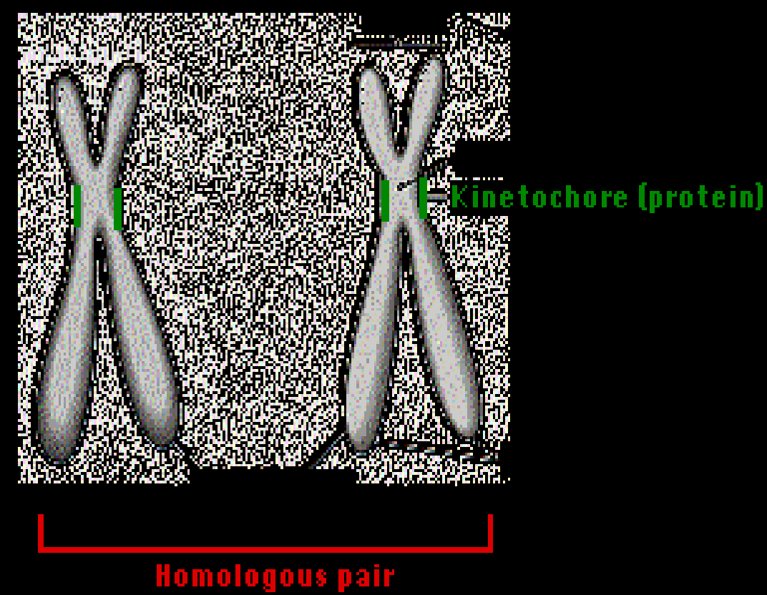
CHROMOSOMES

Slide 3
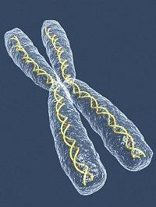
Chromosomes…
The hereditary material
Vehicles of transmission of characters from generation after generation
The genes – the unit of heredity are
located inside the chromosome, in a linear sequence in the nucleus
Chromosomes
Darkly stained, rod shaped bodies visible under light
microscope
Composed of DNA, RNA and Histones – DNA is the major genetic constituent of chromosomes
Appear as coiled threads in early nuclear division
Become condensed at later stages of cell division

Slide 4
Strasburger (1875) - found thread like structures
Waldeyer (1888) - coined the term chromosomes (chroma – color; soma-body)
Assume various shape and size- cell division
In interphase- decoiled; Metaphase- condensed
Chromosome number of a species- CONSTANT
Somatic chromosome number - 2n
Gametic chromosome number - n
The basic chromosome number is x

Slide 5
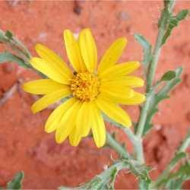
Chromosome number remain constant for a species
Lowest 2n = 4 in Haplopappus gracilis of Compositae
Highest 2n = >1200 in
Ophioglossum of Pteridophyta
Size of chromosomes
Length – 0.25 micron in fungi to 30 micron in Trillium
Breadth – 0.2 micron to 2.0 micron
Haplopappus

Slide 6
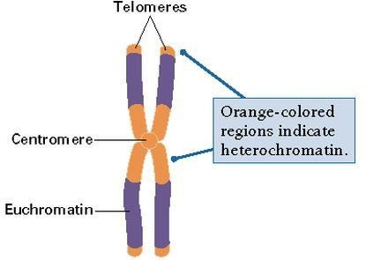
Within the chromosome, there are recognizable structures
Centromeres
Chromatids
NOR’s
Telomeres
Unusual forms of chromosomes (species specific)
Lampbrush chromosomes
Polytene chromosomes
B chromosomes

Slide 7
Chemical composition of chromosome
The chromosomes are composed of DNA and protein.
Generally DNA is about 40% and protein 60%.
The DNA consists of nucleotides
The protein is histone which consists of amino acids arginine and lysine in abundance besides other amino acids.
The presence arginine and lysine amino acids make the histone protein, a positively charged particle.
The DNA show negative charge due to phosphate.

Slide 8
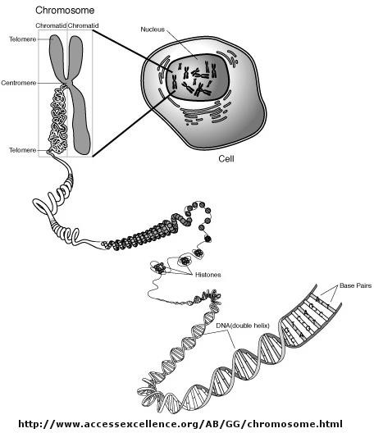

Slide 9
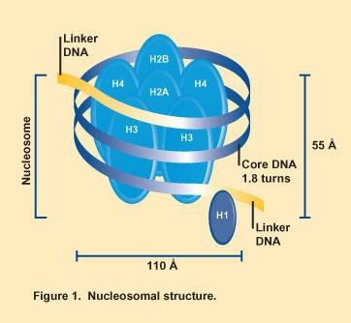
Nucleosome
The basic structural unit of chromatin in eukaryotes, composed of eight histone molecules wrapped by a segment of DNA
Nucleosomes occur at intervals along a continuous strand of DNA

Slide 10
Nucleosome
A polynucleotide part consisting of 200 nucleotides base pairs of the DNA takes two turn on the core of eight histone proteins forming a complex known as nucleosome.
The negatively charged coil of polynucleotide is strongly attracted by the positively charged histone protein.
The nucleosome appears as a beaded structure on the string
under electron microscope.
Two nucleosomes are joined by linker DNA consisting of upto 200 nucleotides.
Each nucleosome units further wrap up into higher order coil called super coil.

Slide 12
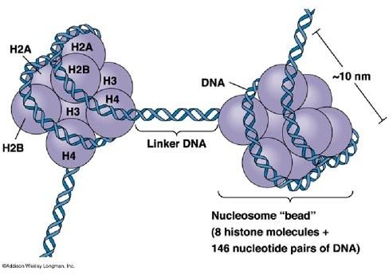

Slide 13
Nucleosome
A typical human chromosome consist of about 140 million nucleotides in its DNA which are repeatedly
arranged as
beaded structures called nucleosomes on a string.
Highly condensed portions of chromatin heterochromatin.
are called
If these remain permanently condensed, they do not transcribe.
The chromatin which is condensed only during cell division but remains in open configuration in an undividing cell is transcribed and thus genes are expressed. It is euchromatin.

Slide 14
Flemming (1882) discovered two structures at cytological level
Heitz (1928) coined as HETEROCHROMATIN
Found proximal to centromere, indistinguishable from Euchromatin at metaphase
EUCHROMATIN is genetically active and less contracted regions
Principal functional regions
Pachytene stage of meiosis is ideal for studying chromosome morphology

Slide 15
HETEROCHROMATIN
Depicted as dark band in chromosome map
Can be visualised by C - band technique and FISH technique
Can be isolated by density gradient centrifugation
Distributed near the centromeres, telomeres, NOR’s and intercalary regions
Large blocks of telomeric heterochromatin is located in short chromosome (Y) in Human
Stains during interphase – heteropycnosis
Destains during metaphase

Slide 16
Heteropycnosis:
Differential condensation of certain chromosomes, such as sex chromosomes, or chromosome parts.

Slide 17
Two types of heterochromatin
Constitutive heterochromatin or inherited
Facultative heterochromatin or appearing during development
After the discovery of repetitive sequences, it was found that heterochromatin regions are made of repeated DNA sequences
No specific functions, but involved in chromosome metabolism and cytoplasmic synthesis
The variation in heterochromatin level helps in studying the Biodiversity
The change in total DNA amount due to repeated DNA sequences of heterochromatin results in evolution

Slide 18
Constitutive heterochromatin is usually repetitive and forms structural functions such as centromeres
or telomeres
Facultative heterochromatin or appearing during development
An example of facultative heterochromatin is
X-chromosome inactivation in female mammals: one X chromosome is packaged as facultative heterochromatin and silenced, while the other X chromosome is packaged as euchromatin and expressed.

Slide 19
S.N | Euchromatin | Heterochromatin
1. | Less condensed region | More condensed region
2. | Loosely coiled chromatin fibres | More tightly folded chromatin fibres
3. | Deeply stains- cell division; less stain -interphase | Less stain - cell division; Deeply stain -interphase
4. | Genetically active - has unique DNA | Genetically less active – has repetitive DNA
5. | Can synthesise mRNA in vitro | Unable to synthesise mRNA in vitro
6. | DNA replication is earlier – in the S phase | DNA replication is at later stage – at the start of cell division
7. | This region is not sticky | This region is sticky
8. | Cross over frequency is more | Cross over frequency is less
9. | Does not show heteropycnosis | show heteropycnosis

Slide 20
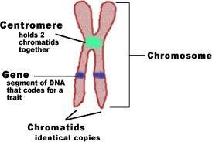
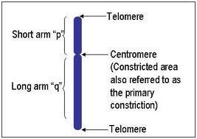
CENTOMERES(Primary constriction) - Kinetochore
Important for normal functioning of chromosomes
Attachment point for spindle fibres
Helps in movement of chromosomes
Size of the centromere is polymorphic
They are destained at metaphase and stained at interphase

Slide 21
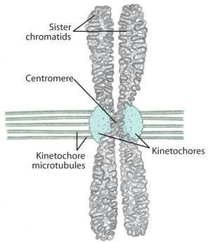
CHROMATID
One of the two longitudinal subunits of chromosome
They get separated during Anaphase
Two types – sister and non sister chromatids
Sister chromatids derived from the same chromosome
Non sister chromatids are from homologous chromosome
They are formed due to DNA replication during Interphase
The two chromatids are held together by centromere
After separation at Anaphase, each chromatid becomes a chromosome
a

Slide 22
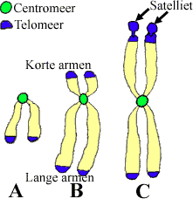
Secondary constriction
Constricted narrow region other than centromere
It has constant position – can be used as useful marker
Found on the short arm of the chromosome
A chromosome segment separated by one Secondary constriction is called Satellite or SAT chromosome
The SAT chromosomes are associated with NOR

Slide 23
CHROMOMERES
Some heavily stained, bead like projections are seen along the entire length of the chromosome
– called chromomeres
They are the local coiling of the continuous DNA thread
They are the unit of DNA replication, RNA synthesis and RNA processing
Two types of Chromomeres – Macro and Micro chromomeres
The number of chromomeres is usually constant; which serve as a reliable morphological characteristic

Slide 24

TELOMERES (Telo- ends; meros- parts)
Named by H.J.Muller
Made up of DNA and protein
Occur at the ends of the chromosomes
They are heterochromatic and protect the ends
The protection of ends - Telomerase
Presence of telomeres – helps to distinguish chromosome breaks
Essential component for chromosomal integrity
Function of telomere is to stop chromosomes degradation
Can be stained using T- banding technique
In light microscope, dark telomeres can be seen against light background

Slide 25
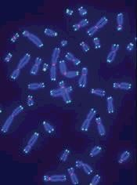

Slide 26
NUCLEOLUS ORGANISING REGION
Nucleolus – visible structures in nucleus
Site of Ribosome formation
It is a secondary constriction or satellited segment
Responsible for organisation of Nucleolus
Contains genes coding for 18S and 28 S ribosomal RNA
r RNA is transcribed and processed
Visualised by staining with Silver Nitrate

Slide 27
KARYOTYPE
Morphological representation of a chromosome complement with regard to the number and shape of the chromosome
The form, size, shape and number of chromosomes in the basic set of an individual
Karyotype suggests primitive or advanced feature of an organism
Karyotype is arrangement of chromosome based on size and shape

Slide 28
Prepared from mitotic metaphase and contain information on
the location of centromere
Secondary constriction
Satellite
Length and breadth of the chromosome
Arrangement of chromosome - largest to smallest chromosome

Slide 29
Two ways represent the chromosome set of a species
Karyogram
Photomicrographs of the chromosome of a single somatic metaphase cell are clipped out and arranged in homologous pairs according to their size
If the chromosomes are small, they are arranged in groups

Slide 30
2. IDIOGRAM
It is the graphical representation of the karyotype
Idiograms are usually prepared to show the haploid chromosome set of a species
It is prepared from the measurement of somatic metaphase chromosomes
Individual chromosomes must be identified for this purpose
Techniques for identifying specific chromosome segments
Fluorescent staining
Pulse labelling
Chromosome banding

Slide 31
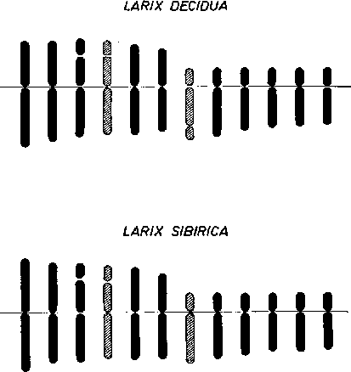
FIGURE 1. - idiograms of Larix decidua and L. sibirica.

Slide 32
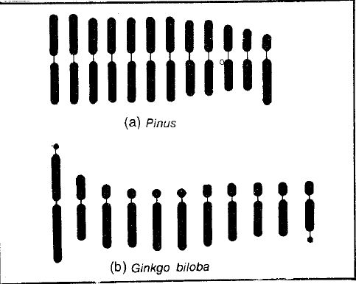
Karyotype may be Symmetrical or Asymmetrical

Slide 33
Karyotype may be Symmetrical or Asymmetrical
This was developed by Levitzky (1931)
When all the chromosomes of a species are of approximately the same size and have median or sub median centromere, the karyotype is said to be Symmetrical.
When the chromosomes of an individual differ in size and position of centromere the karyotype is called Asymmetric or heterogenous

Slide 34
The symmetrical karyotype represents the primitive type from which Asymmetrical karyotypes have evolved through structural changes
Asymmetrical karyotype is due to pericentric inversions and unequal translocations, which change the position of the centromere

Slide 35

Chromosome Banding
chromosome banding is developed based on the presence of heterochromatin and euchromatin.
heterochromatin is darkly stained whereas euchromatin is lightly stained during chromosome staining.
Band is defined as that part of a chromosome which is clearly distinguishable from its adjacent segments by appearing darker or brighter with one or more banding techniques.
- there are a few types of chromosome banding: G-banding, C-banding, Q-banding, R-banding etc.

Slide 36



G-Banding
G-banding is obtained with Giemsa stain following digestion of chromosomes with enzyme trypsin.
Giemsa stain, named after Gustav Giemsa, an early malariologist, is used for the histopathological diagnosis of malaria and other parasites.
-It is a mixture of methylene blue and eosin. It is specific for the phosphate groups of DNA and attaches itself to regions of DNA where there are high amounts of adenine- thymine bonding.
it yields a series of lightly and darkly stained bands - the dark regions tend to be heterochromatic, late-replicating and AT rich. The light regions tend to be euchromatic, early-replicating and GC rich .

Slide 37
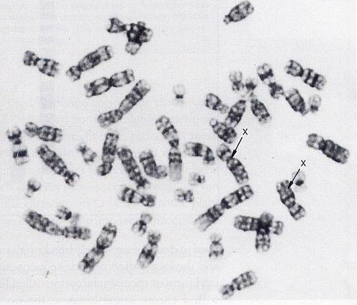
G-Banding
G-banding of human female metaphase chromosomes

Slide 38

Q-Banding
Q-banding is a fluorescent pattern obtained using quinacrine for staining. The pattern of bands is very similar to that seen in G-banding.
Quinacrine banding (Q-banding) was the first staining method used to produce specific banding patterns for mammalian chromosomes.
It is especially useful for distinguishing the Y chromosome.
This method requires a fluorescence microscope (quinacrine fluoresces strongly in the ultraviolet) and is no longer as widely used as G-banding.

Slide 39
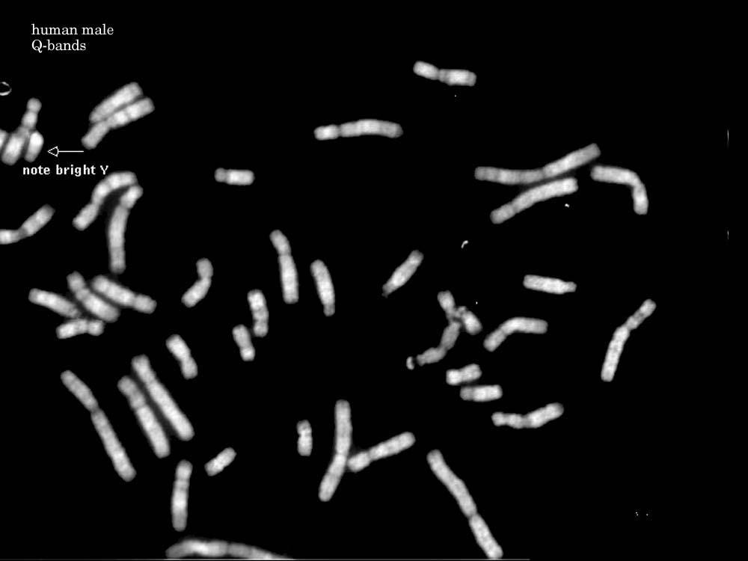
Q-Banding
Q-banding of human male metaphase chromosomes

Slide 40

R-Banding
R-banding is the reverse of G-banding (the R stands for "reverse").
the dark regions are euchromatic (guanine-cytosine rich regions) and the light regions are heterochromatic (thymine-adenine rich regions).
telomeres are stained well by this procedure.
Reverse banding (R-banding) requires heat treatment and reverses the usual white and black pattern that is seen in G-bands and Q-bands.

Slide 41
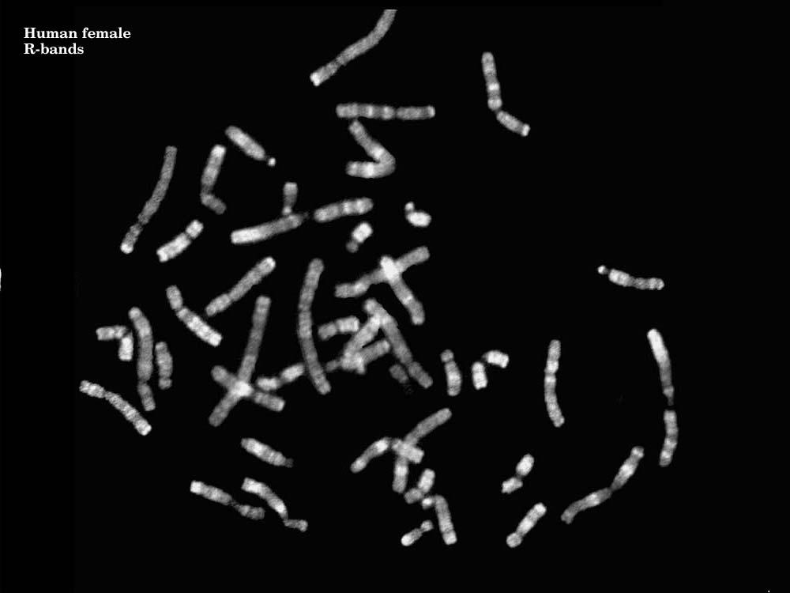
R-Banding
R-banding of human female metaphase chromosomes

Slide 42

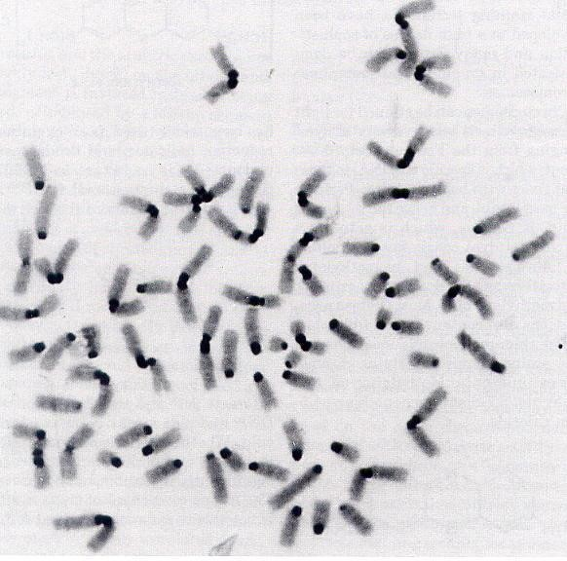
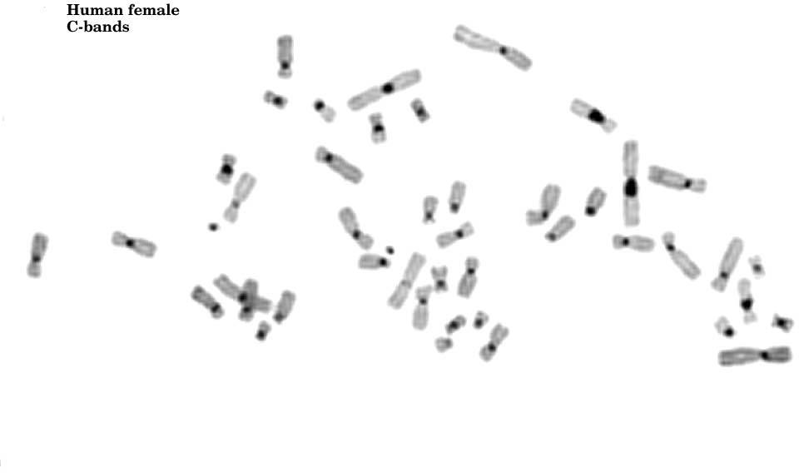
C-Banding
- C-banding stains the constitutive heterochromatin, which usually present near the centromere.
Chromosomes of mouse
Chromosomes of human female

